Slide 1
SWAP RESTRICTIONS
DESIGN SPECIFICATIONS
06-MAR-2023

Slide 2
ACRONYMS
Acronym | Description
EWP | Ericsson Wallet Platform
CS | Charging System
CLM | Customer Lifecycle Management system

Slide 3
USECASE LIST
Use Case ID | Use Case | URS Link | SD Ref | Impacted Systems
1 | Restrict Swap based on MoMo wallet balance | https://mtnnigeria.atlassian.net/browse/FT-193 | SD 1 | Biosmart, CLM, EWP, ESF
2 | Restrict Swap based on account balance | https://mtnnigeria.atlassian.net/browse/FT-237 | SD 2 | Biosmart, CLM, CS, ESF

Slide 4
1. RESTRICT SWAP BASED ON MOMO WALLET BALANCE

Slide 5
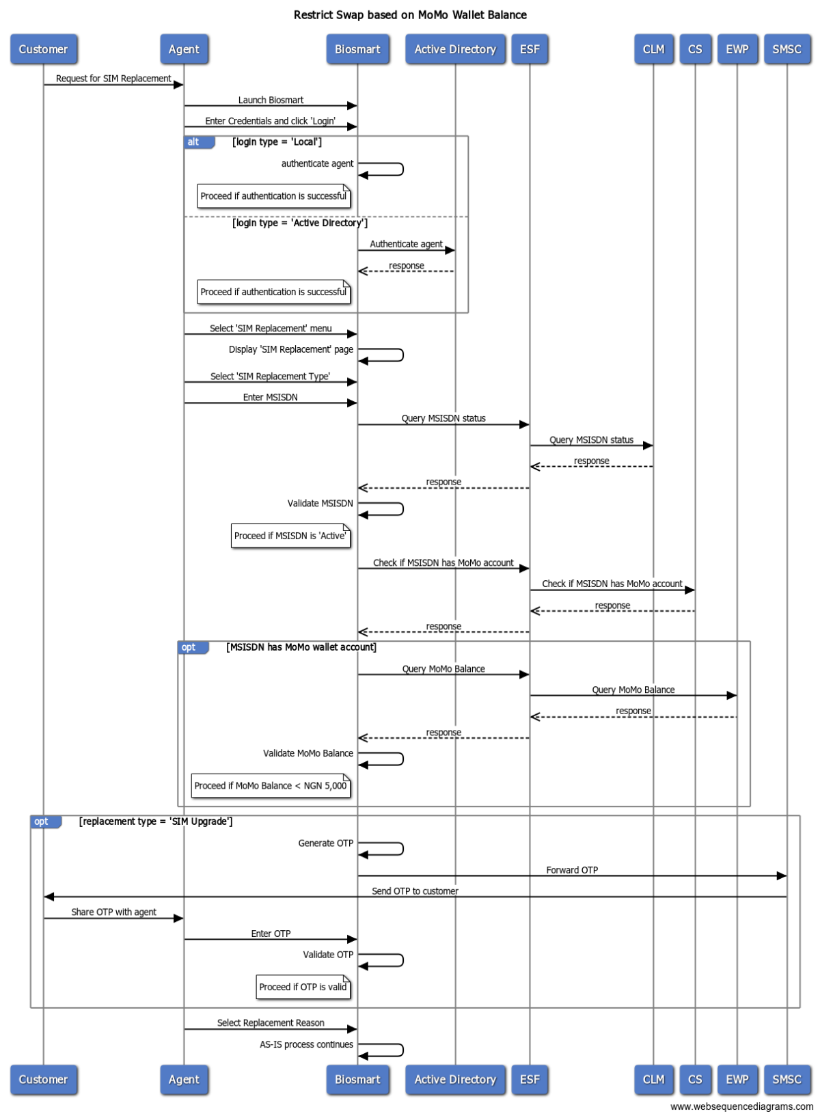
SD 01: Restrict Swap based on MoMo Wallet Balance - Biosmart

Slide 6
Work Package – Restrict Swap based on MoMo wallet balance
Biosmart | CLM | EWP | ESF
Add business rule to validate line’s MoMo wallet balance during SIM Swap | Add business rule to validate line’s MoMo wallet balance during SIM Swap Add like an icon /flag on clm ui indicating that line(msisdn) has a momo wallet account. | Expose API to check if line has MoMo account Expose API to query MoMo wallet balance | Wrap MoMo account check API Wrap Query MoMo wallet balance API

Slide 7
2. RESTRICT SWAP BASED ON ACCOUNT BALANCE

Slide 8
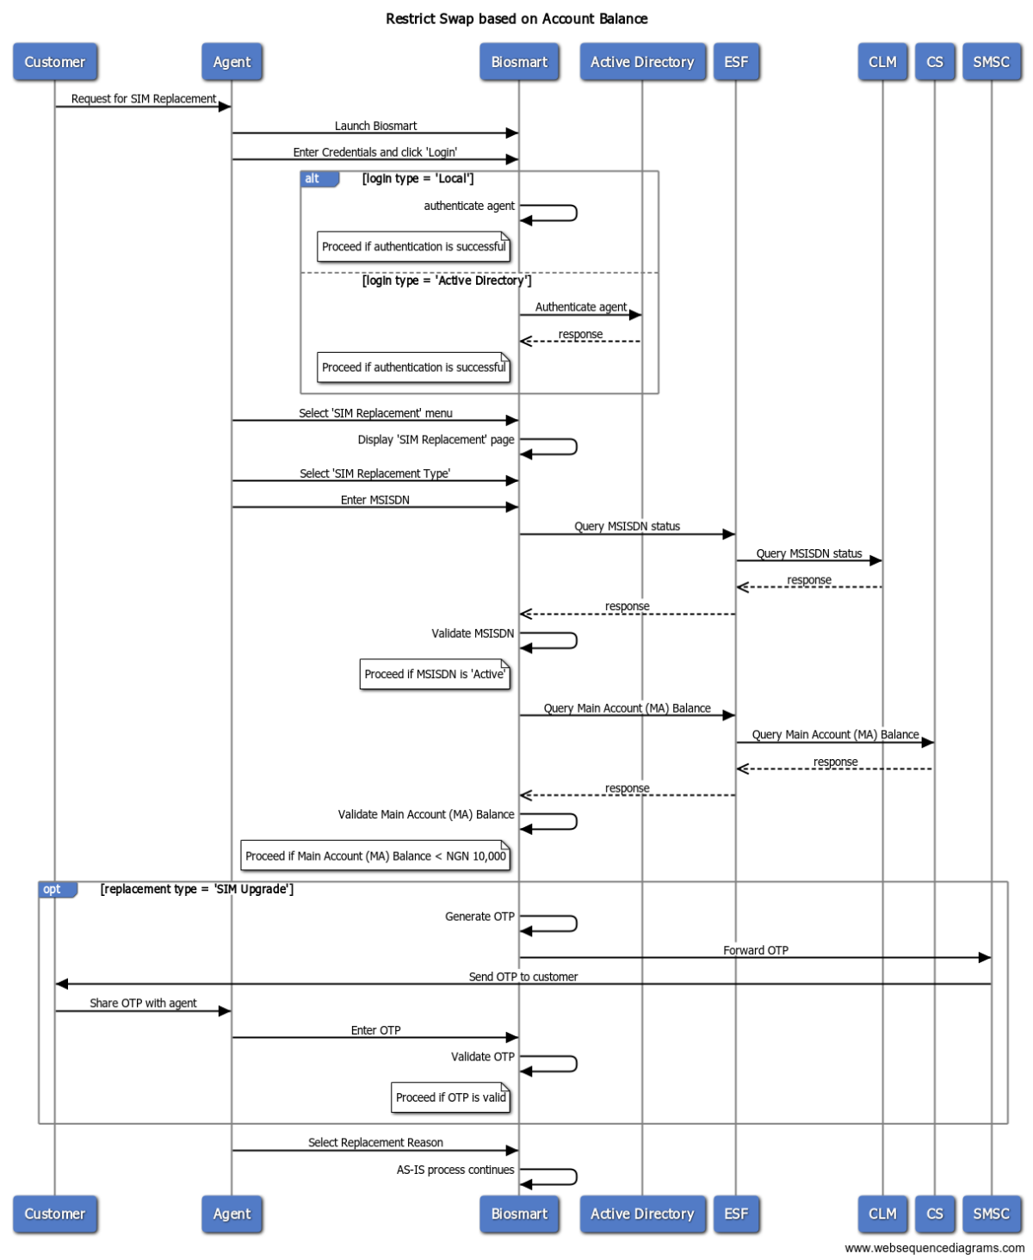
SD 02: Restrict Swap based on Account Balance - Biosmart

Slide 9
Work Package – Restrict Swap based on Account Balance
Biosmart | CLM | CS | ESF
Add business rule to validate line’s main account (MA) balance during SIM Swap | Add business rule to validate line’s main account (MA) balance during SIM Swap | Expose API to query line’s main account (MA) balance | Wrap Query Main Account (MA) Balance API

Slide 10
Thank you

